Slide 1
AI Based Computer Vision Accident Detection
Reuben George Mathew
Jeffrey Aaron Paul
Rohan Jamadagni
Sandeep S Budhya
RG Shruthii
Jennifer Jeeyar
Runtime Terror
DSCE, Bangalore
PS Number: IC463
Category: Smart Cities (AICTE)

Slide 2
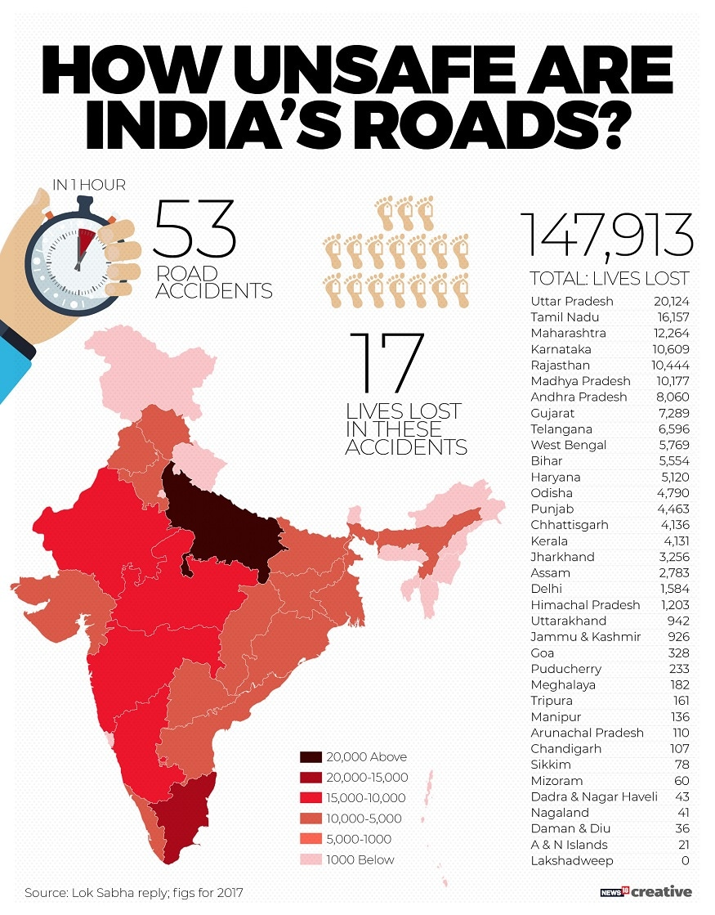
A Few Numbers
An estimated 53 accidents occur every hour in India.
1.5 Lakh people lose their lives every year due to on road accidents.
The WHO estimates that traffic accidents cost most countries about 3% of their GDP.
A Patients chance of survival is greatly increased if they receive medical care within the first hour of injury
[World Health Organization]
Average Ambulance Response Time: 41-47 Minutes
[CAG Report, GoMP 2017]
Rapid ambulance response is associated with a higher rate of survival.
Highways which only account for about 5% of the total road network witnesses over 55% of all accidents.
[Ministry of Road Transport and Highways, Government of India]

Slide 3

Approach
Capture Footage and Split into frames
Apply Object Detection
Custom Collision Detection Algorithm
Classify Image as Accident/
Not Accident
Send Required Information to Web-Application
OpenCV
Pytorch YOLOv3
Math
Formulae
Keras/ Tensorflow
Vue.js/
Firebase

Slide 4


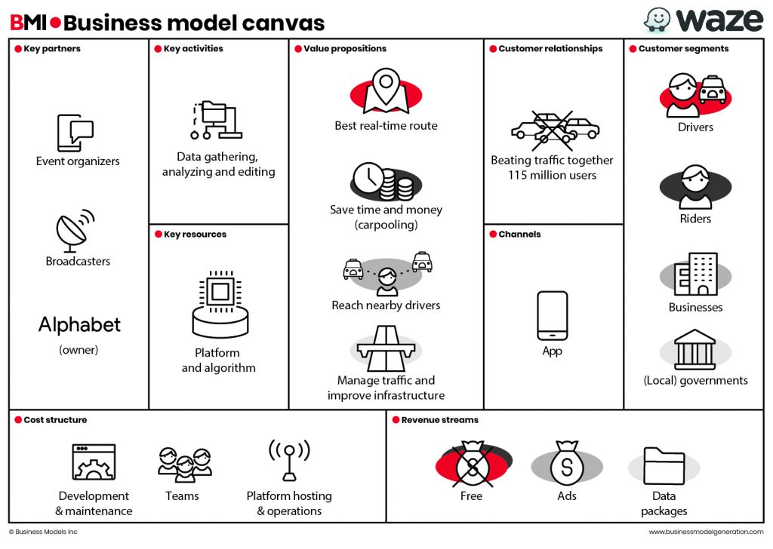



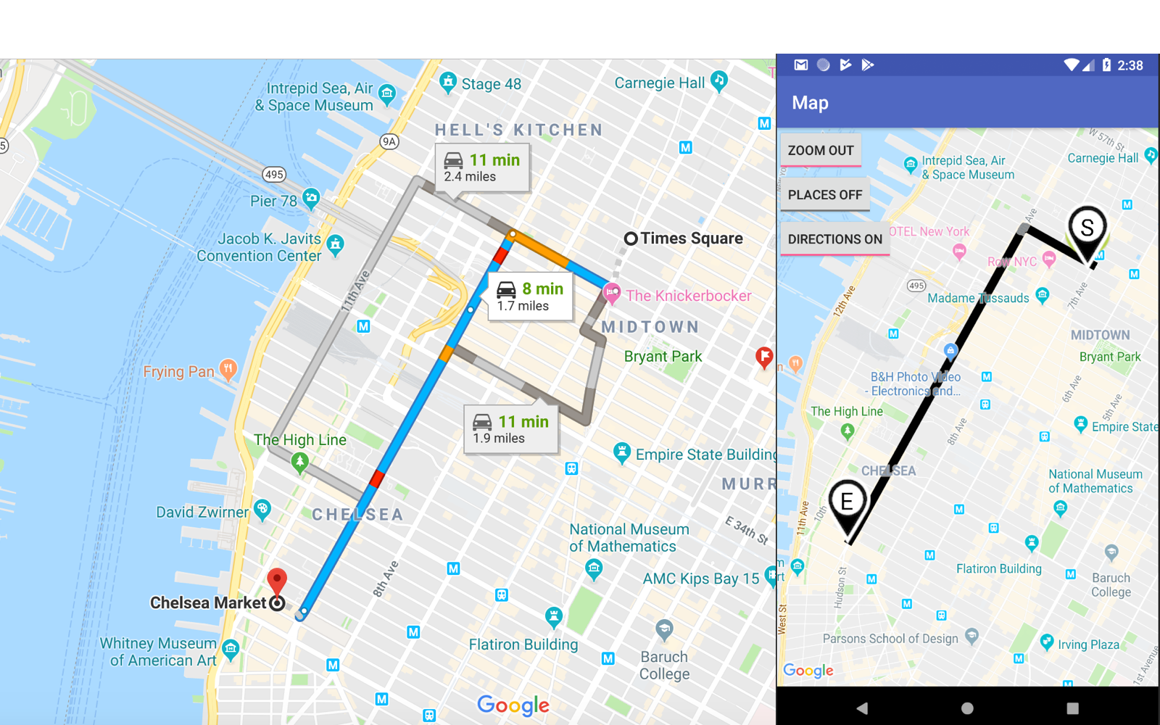


Technical - Architecture
Image
Accident
Detected?
Yes
Location
Data fed to server
Time
CCTV captures footage
Platform
AI Based Collision Detection Algorithm and Accident Classifier
No
Data Sent To Firebase
No Action
Change in the database recognized and webpage updated
08:26 PM
Vue.js WebApp
Displays information
Firebase Database and Storage
Hospital/Police Users Respond Accordingly

Slide 5
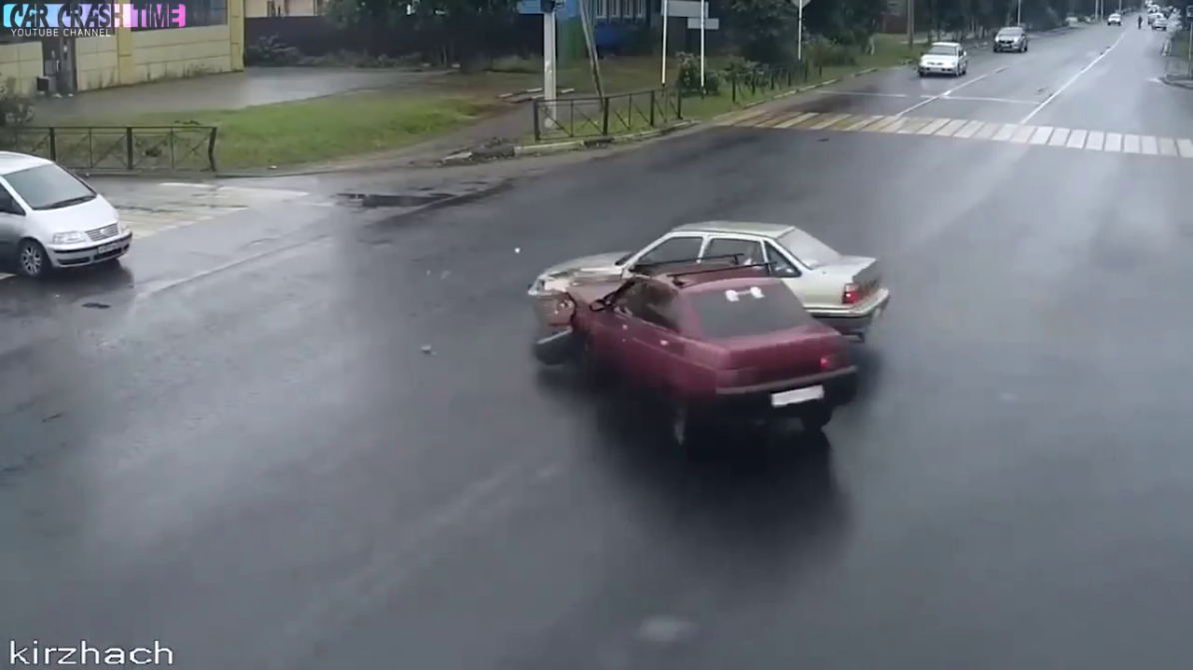
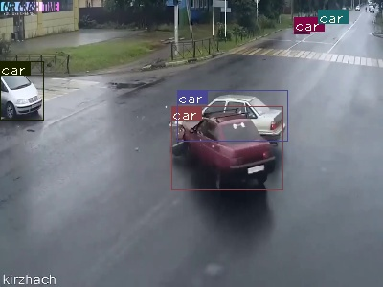
YOLO Object Detection At Work
Image Frame Extracted From Video
Bounding Boxes Marked On Frame

Slide 6
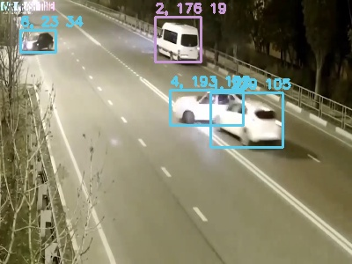
Technical – Algorithm
Difference Between Y Centres
Half Height Sum
Difference Between X Centres
Half Width Sum
Collision Condition:
Half Width Sum > Difference Between X Centres (AND)
Half Height Sum > Difference Between Y Centres
Proximity Condition:
Half Width Sum - Difference Between X Centres < 5% Sum of Widths of Both Boxes (AND)
Half Height Sum - Difference Between Y Centres < 5% Sum of Heights of Both Boxes

Slide 7
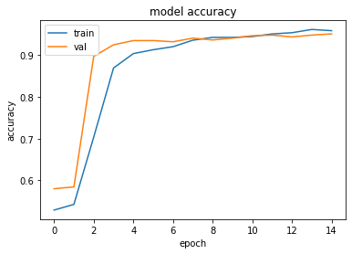
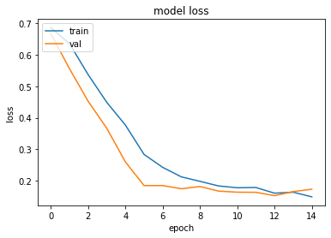
Technical – Model
The classifier is a Densenet-201 with Imagenet weights model which is used for feature extraction where the last few layers of the model are removed.
After the feature extraction process, a flattened vector of shape (1920,) is then sent to a shallow Artificial Neural Network (ANN) which consists of a few Dense layers combined with Dropout Layers to prevent overfitting.
This causes the image extracted from the CCTV video footage to focus on an area of the image rather than the image as a whole.
This methodology can locate the accident in an image and doesn’t rely on various other features such as Intersection over union, entropy and so on.

Slide 8
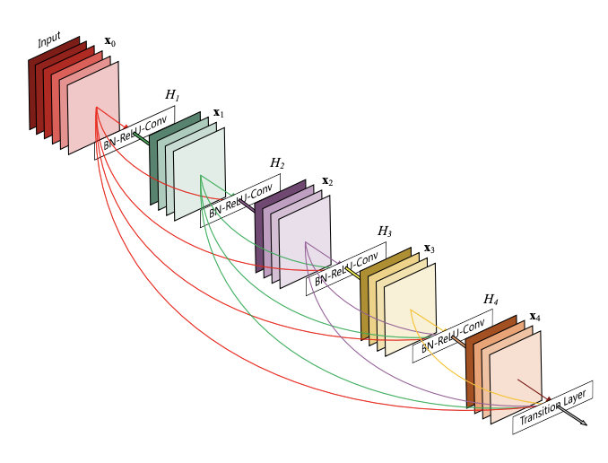
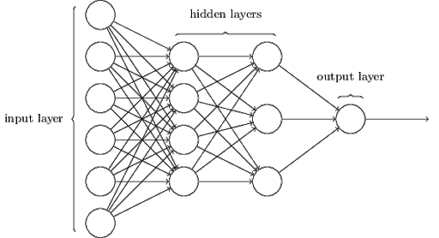
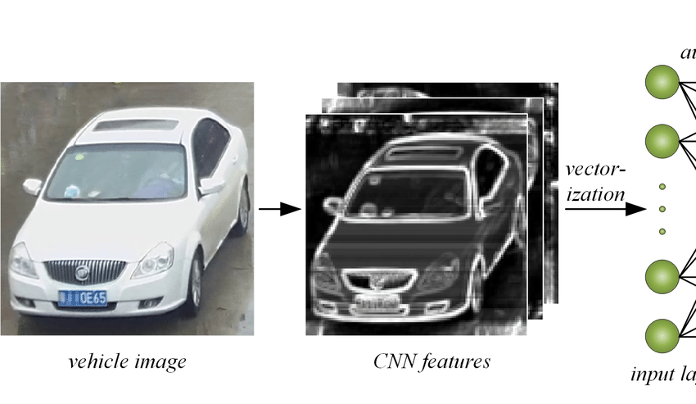
DenseNet+ANN Model Flow
10
DenseNet-201
A Pre-Trained model by Google used for feature extraction
Outputs Score Between 0 and 1
Captured Frame
1920 Shaped Feature Array

Slide 9

Community Outreach Program
Create a community of like-minded volunteers to help out with first aid before the ambulance might arrive.
Volunteers after background checks can be added into the program.
A notification of the accident along with it’s details can be uploaded through WhatsApp/SMS and interested parties can respond with basic medical care.
Target Individuals from Medical Backgrounds
Would reduce the Time of Response even further, thus improving survival rates.

Slide 10
Why We Are Better
Utilizing Sensor Arrays Present In The Vehicle Or A Smartphone
Feature generally reserved for higher-end, premium models.
Generally focused on one parameter only, such as a change in speed or G-Force.
The smartphone is required to have the necessary sensors.
Hardware Based Solutions At Intersections and Junctions
Dependent on weather conditions.
Very expensive.
Covers only individual locations.
Centroid Based Computer Vision Approach
High density traffic causes inaccurate predictions.
Rate of false positives generally higher.
Computationally intensive.
Our Approach
Highly accurate vehicle tracking using the YOLO Object Detection library.
Collisions accurately detected with minimal computation.
Trained Neural Network has an f-1 score of 0.925.
Can be added to the existing CCTV infrastructure.
No Hardware Sensors needed, reducing maintenance costs.

Slide 11

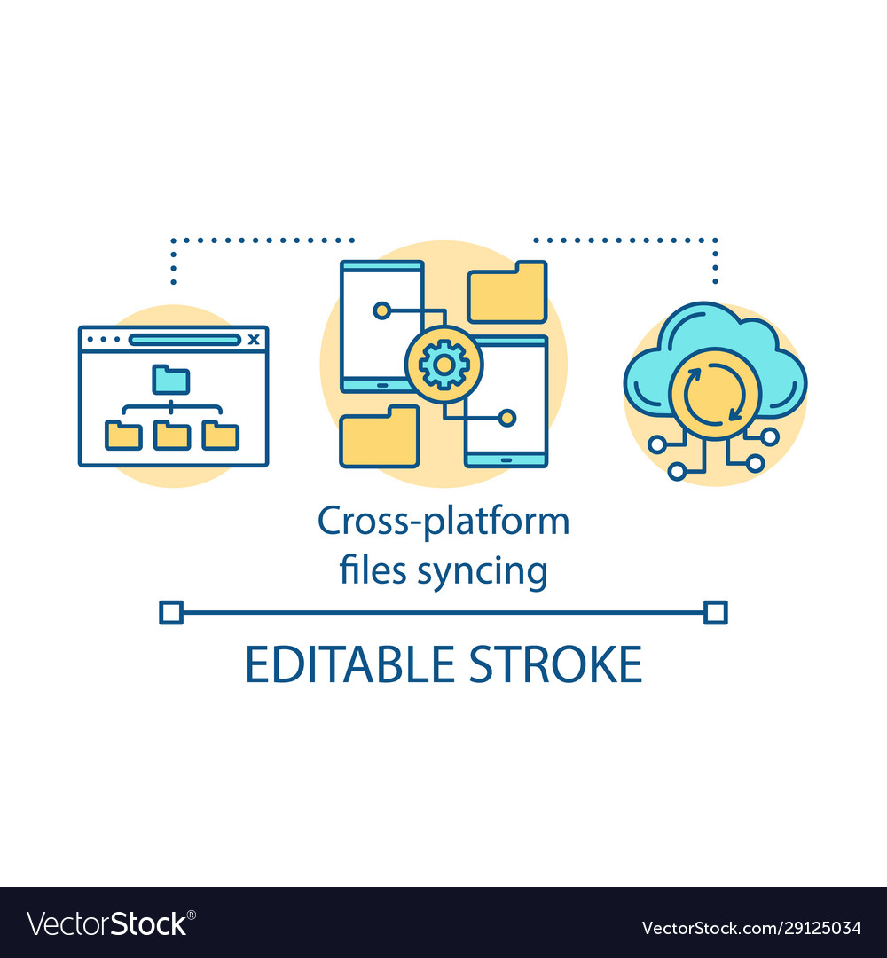









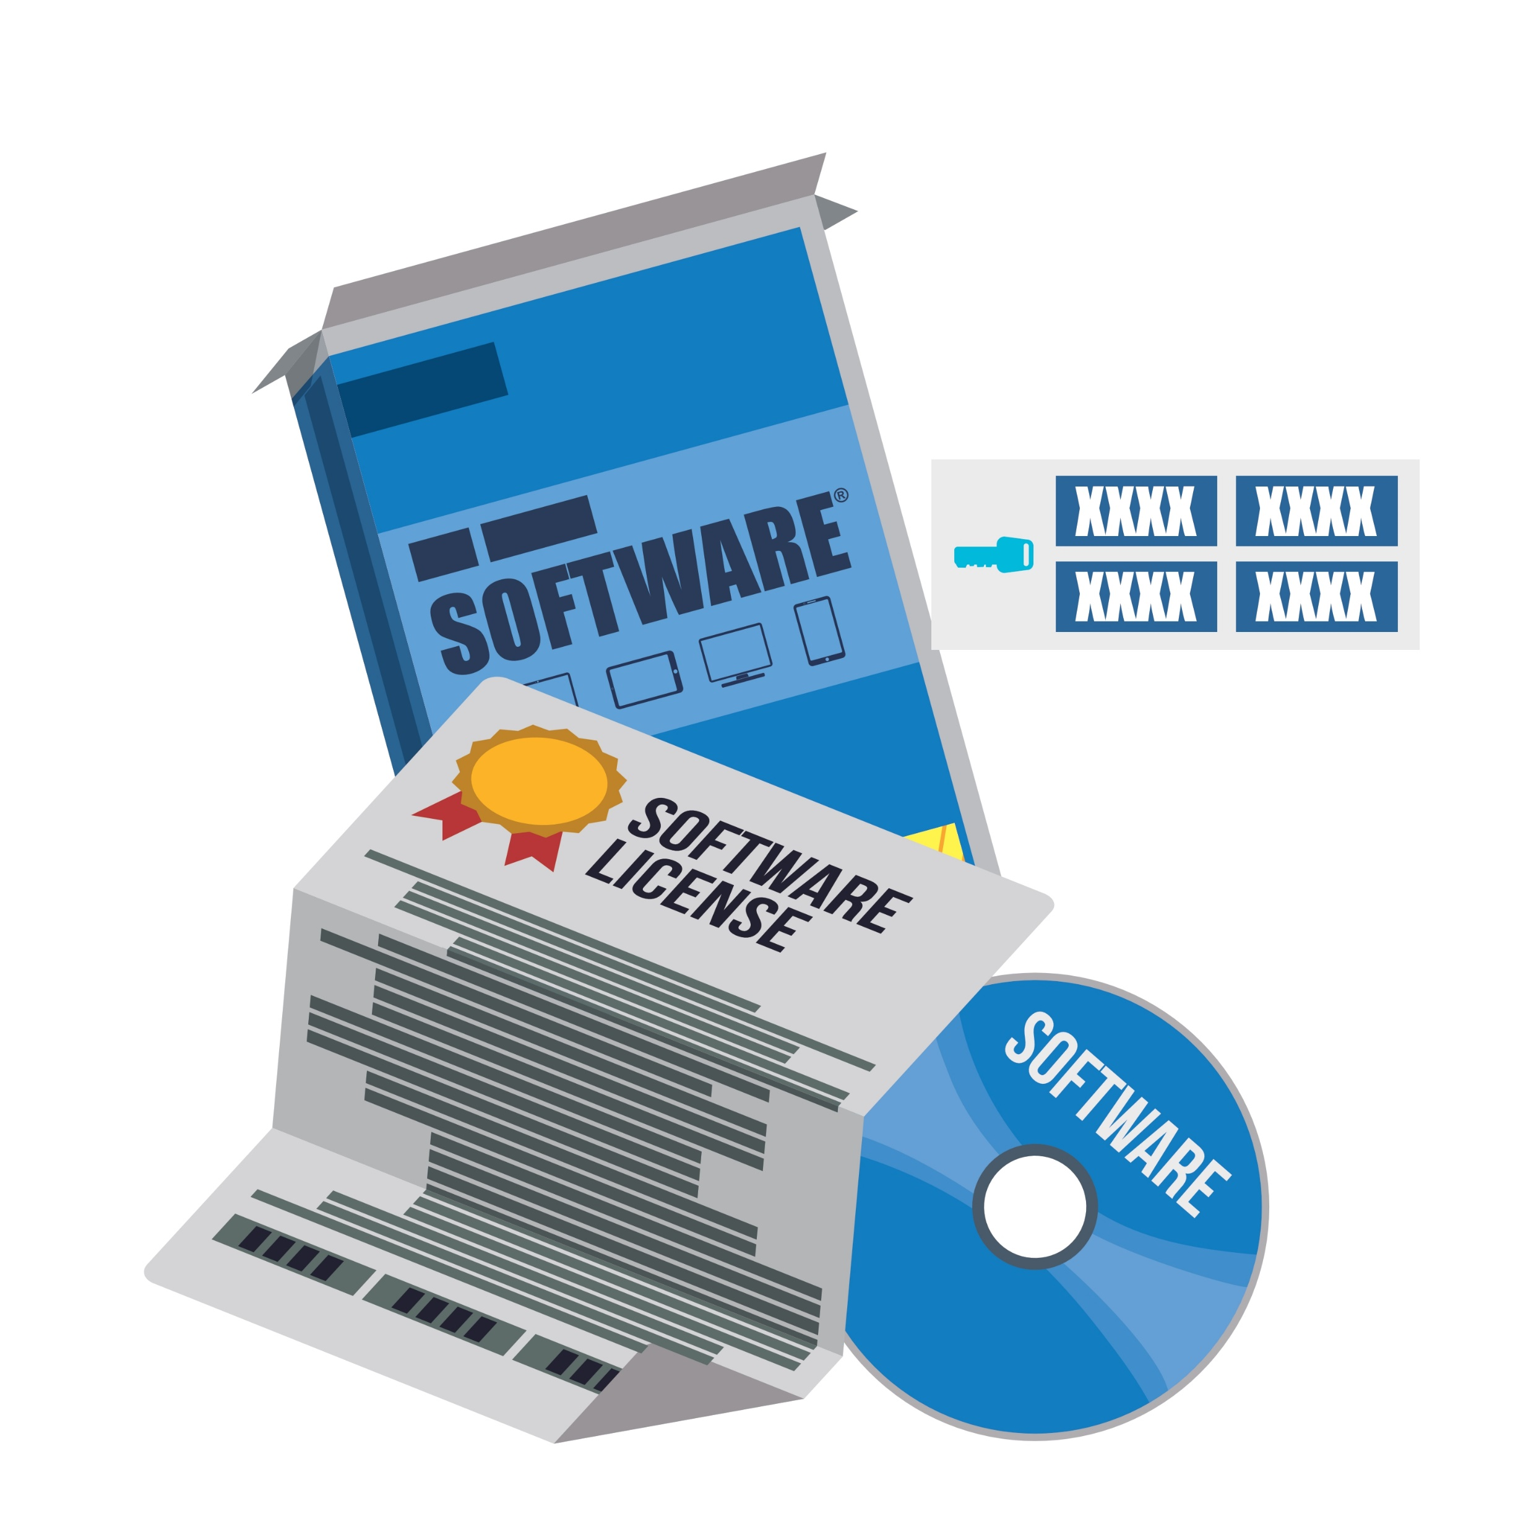
Business Model Canvas
Fastest Route to the scene of the Accident
Platform sharing with customer companies
Police
Drivers
Data Gathering, Analyzing and Processing
Platform Support with Updates
Emergency Response Services
Instantly reach nearby emergency services
Businesses
Cloud Platforms
Captured Video Footage sent and processed on the Cloud
Platform and Algorithm
Improve Transportation Infrastructure
Governments
Development and Maintenance
Teams
Platform Hosting and Operations
Platform Royalties
Software Licensing

Slide 12
Cost Breakdown – Bizon Deep Learning
Base Cost: Rs. 14,78,925
Lifetime Care + 3 Year Warranty
Component | Name | Pricing
Processor | 2 x 10-Core 2.20 GHz Intel Xeon Silver 4210 | Included
RAM | DDR4 2666 MHz ECC 4x16GB | Included
Operating System | Linux Based | Included
Graphics Card | 8 x NVIDIA Quadro RTX 8000 48 GB | + Rs. 28,24,107
HDD | 1TB + 4TB SATA SSD (550 Mb/s) | Included
Network | 10 Gigabit Dual Port Ethernet | Included
UPS Backup | SMT3000RM2UC 3000VA/2700W 120V | + Rs. 97,500
Total Cost | Rs. 43,98,984
Number of Cameras Supported | 96
Cost Per Camera (INR) | Rs. 45,850
Alternate Option
Cheaper Graphics Card - Slower | Tesla K80
Cost Per Camera (INR) | Rs. 32,000

Slide 13
Market Dynamics and Potential
Opportunities
Public-Private Partnership Ecosystems.
Lack of viable and affordable solutions
The Global Road Safety Market is valued approximately USD 2.7 billion in 2018 and is anticipated to grow with a CAGR of more than 9.45% over the period 2019-2027.
The APAC road safety market is projected to grow at the highest CAGR.
NITI Ayog has identified smart cities and transportation as two sectors to focus its efforts towards implementation of AI.
Rising Urban Population and High Demographic Rates.
Rapid Motorization.
Increasing Number of Road Fatalities
Government Initiatives for Enhancing Road Safety – Increased Spending
Drivers
Growing Concerns About the Protection and Privacy of Personal Information.
CCTV Coverage
Lack of Standardized and Uniform Technologies
Challenges and Restraints

Slide 14
Future Roadmap
Improved accuracy of the model with the help of better, more varied datasets to cut down false positives.
Partnerships with companies to create a joint platform for accident response.
Better image processing to detect accident in bad weather.
Utilize incorrectly classified accidents and correct predictions to retrain the model in real time ensuring optimal performance.
Addition of Automatic Number Plate Recognition to retrieve details of those involved in the incident.
Application in the fields of Security and Surveillance in both the public and private sectors with alterations to the core model.

Slide 15
Demo High Traffic Density

Slide 16
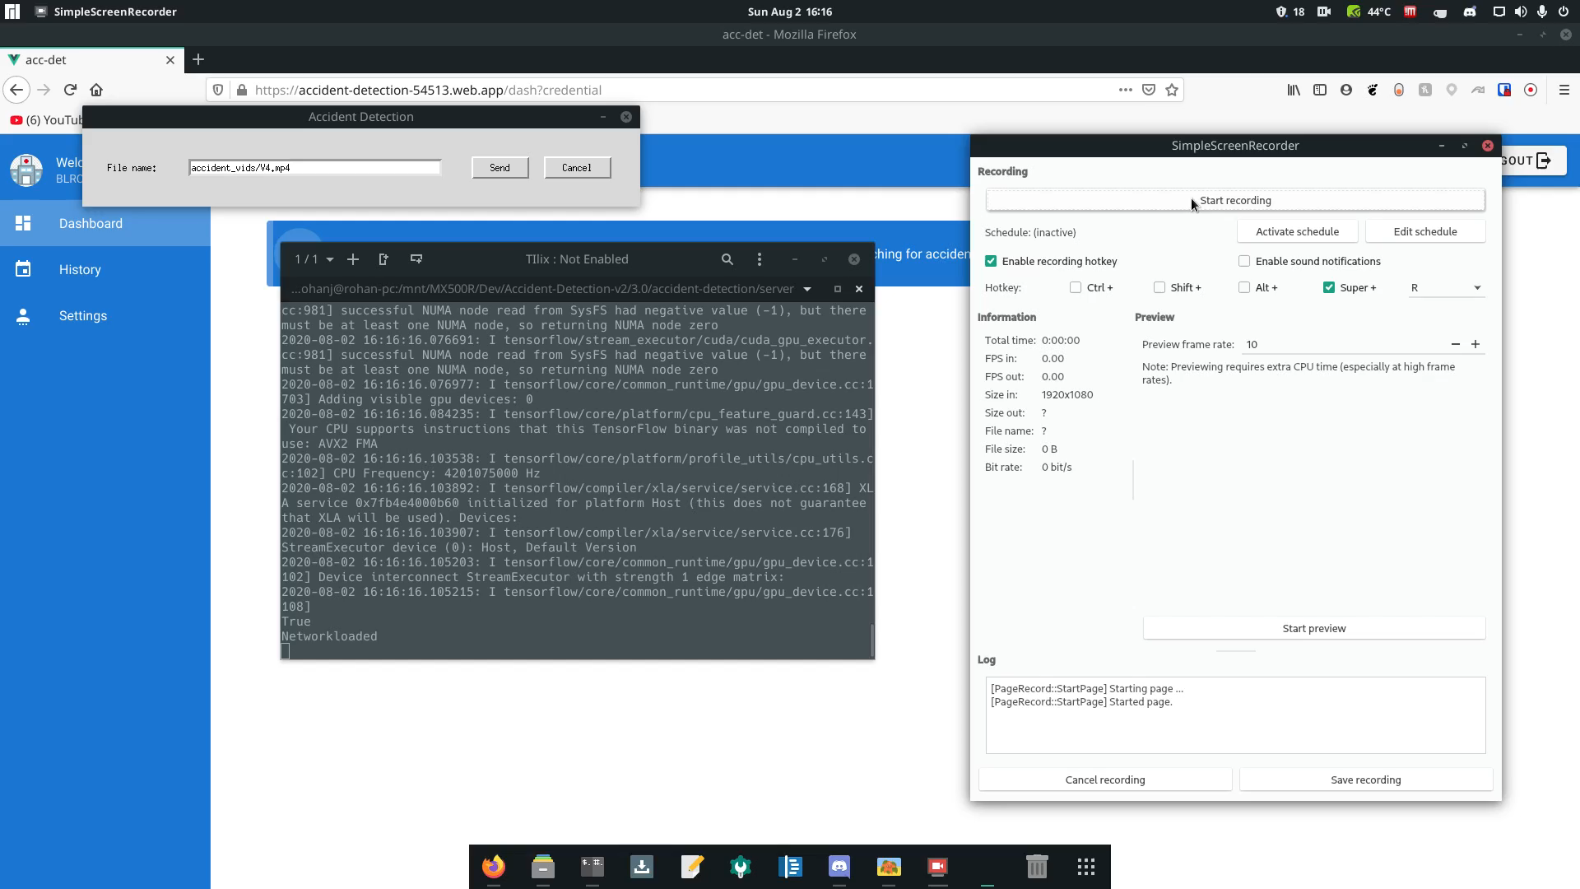

Slide 17
Demo Simultaneous Multi Camera

Slide 18
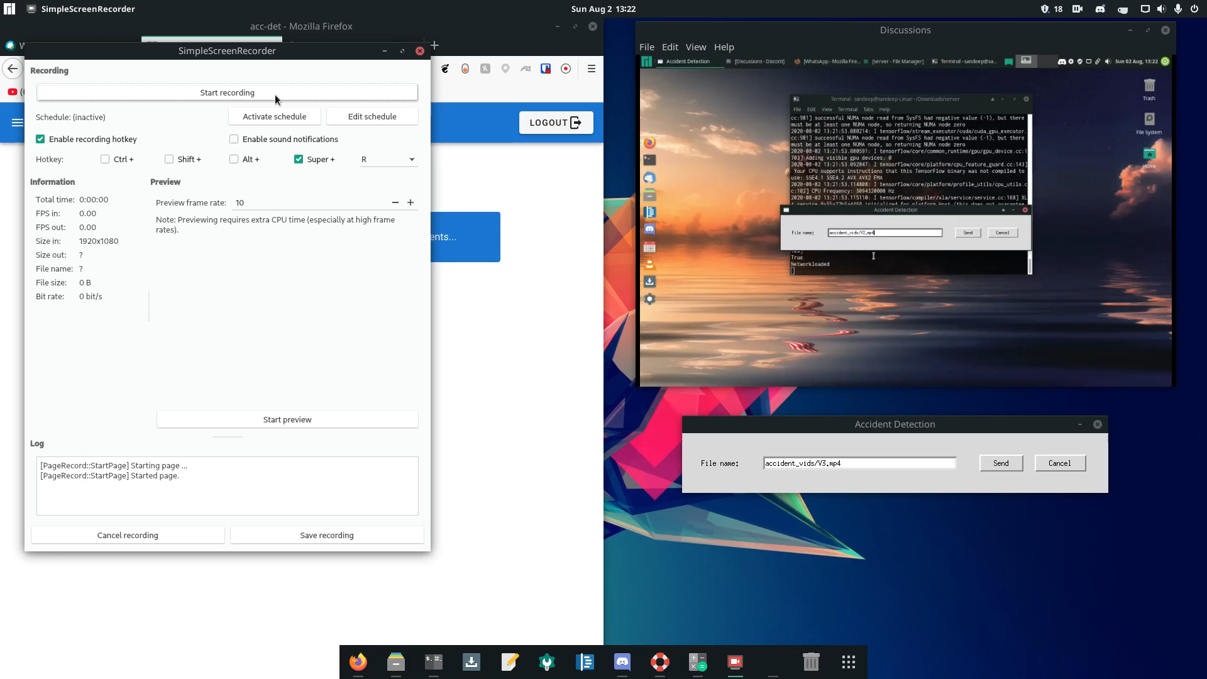

Slide 19
Demo WhatsApp Notification + Night Time

Slide 20
